Slide 1

Customer Classifiers
Group 3:
Kantai Melau
Calum Knight
Adna
Nnamdi Okoroji

Slide 2
Project Overview
Maven Telecommunications are a telecom company that provides phone & internet services to more than 7000 customers in California. We have a customer churn dataset that also specifies the customer demographics amongst other information, and we are going to use this data to perform customer segmentation.
Customer segmentation is a technique used in marketing analytics. We can use machine learning to find particular clusters that share similar attributes. This would then come in handy when marketing so different customer groups can be targeted with specific marketing.
Implementing customer segmentation is very useful for businesses in terms of optimising:
Budgeting
Product design
Customer satisfaction
Promotion
Marketing

Slide 3

Data Source
A data set from Maven Analytics was used.
It has 38 columns and 7044 rows

Slide 4
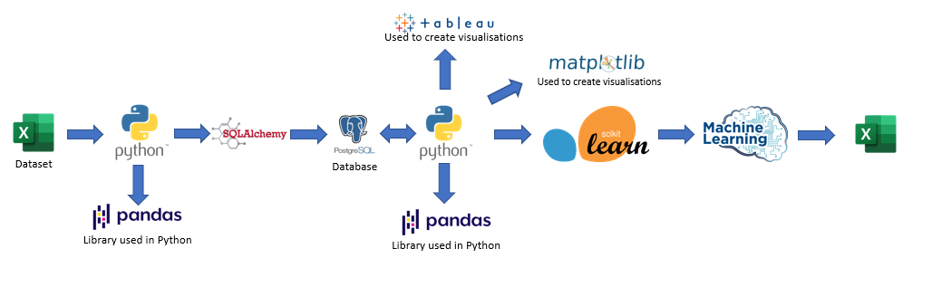
Process

Slide 5
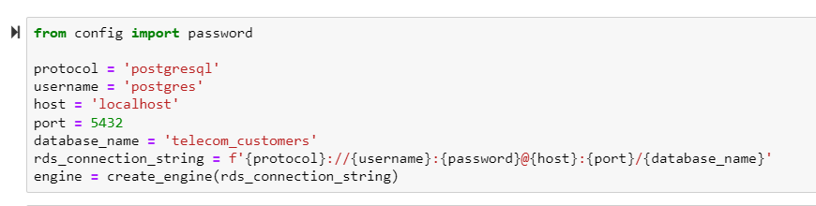
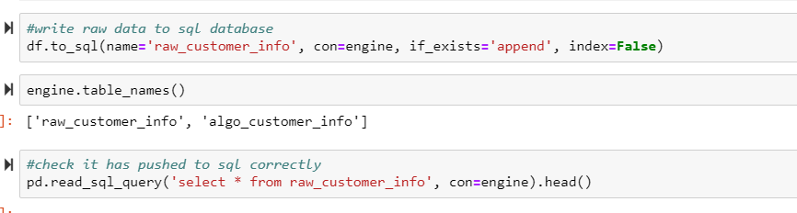
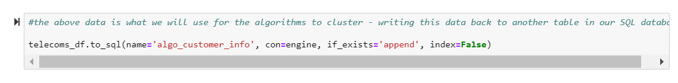
PostgreSQL
We loaded the CSV with our data into Pandas, then cleaned this raw data and wrote that to a table we created in postgresql. After this, we selected the data we wanted (dropped the columns we weren't going to use in the algorithms) and loaded this back into a different table in postgres, so that we have a copy of the data we were going to use for the machine learning algorithms.

Slide 6

Extract, Transform & Load

Slide 7
ETL Process
EXTRACT
TRANSFORM
LOAD
Import data from CSV.
Copy it into an existing SQL database.
Read it from the database
Remove duplicates
Drop null rows
Confirm the existing columns
Drop unwanted columns
Change categorical values to numeric values
The cleansed dataset was then pushed back to the PostgreSQL Data Base for future manipulation.

Slide 8

Exploratory Data Analysis

Slide 9

EDA
Done before Transformation of the data
Tried to identify trends that exist in the data
To identify the relevant columns
Begin to understand the dataset and its features.

Slide 10
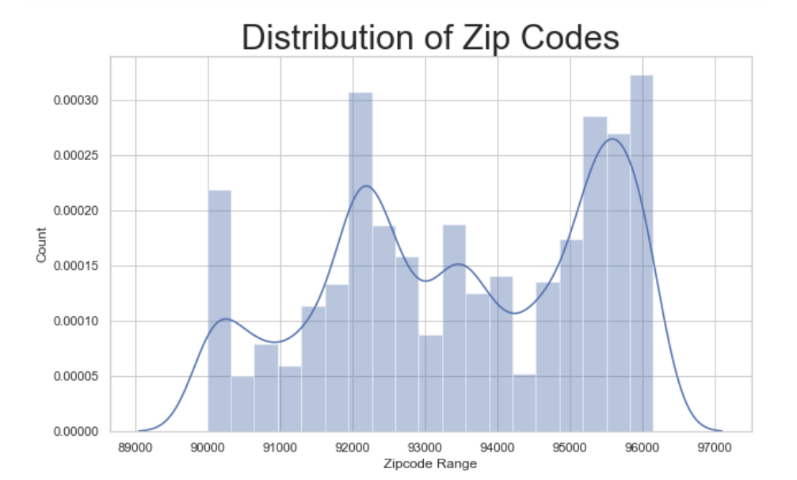
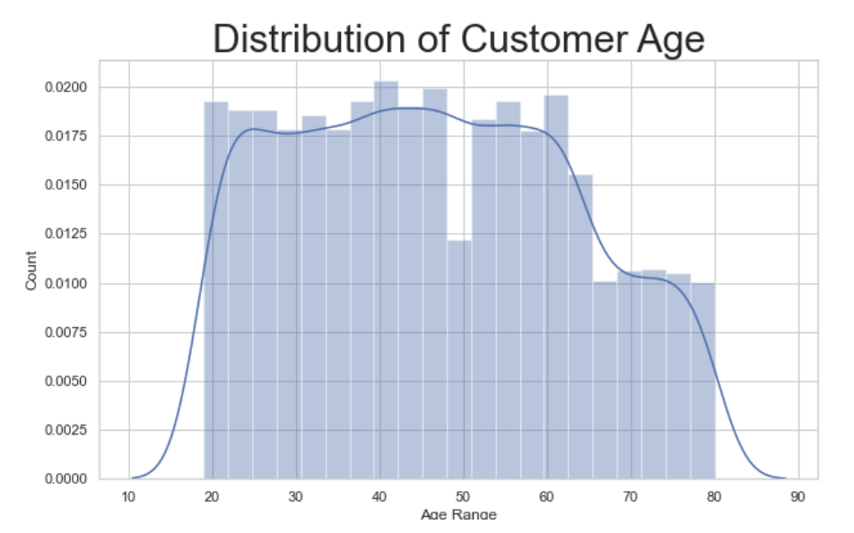
EDA
The graph shows the distribution of ZIP codes. They show that customers are spread across Carlifonia with few zip codes that have higher density of customers.
This shows the distribution by customer age. There are customers across all ages with a few variations as we get older.

Slide 11
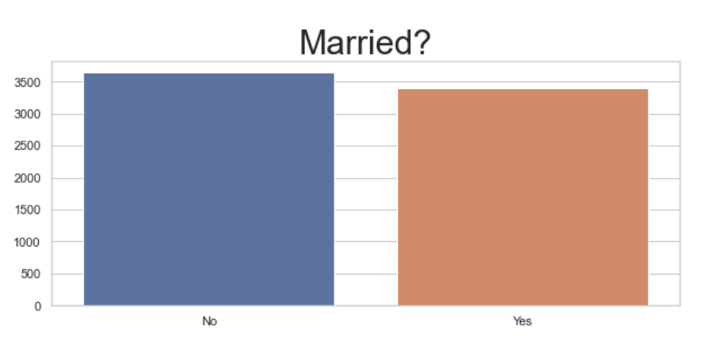
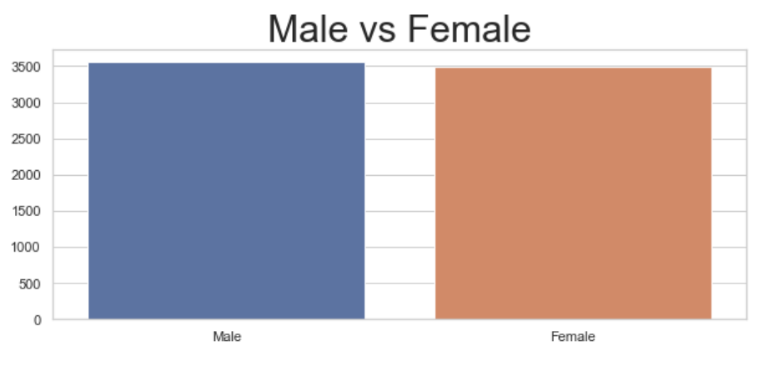
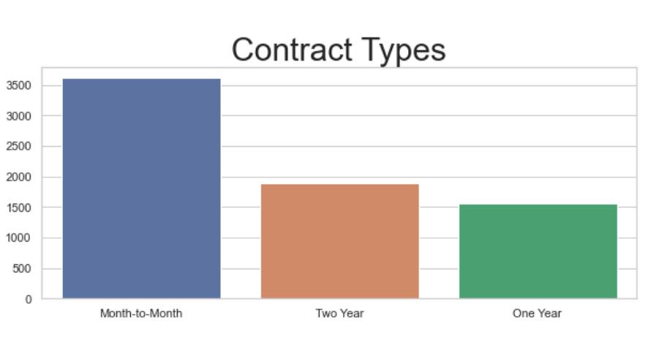
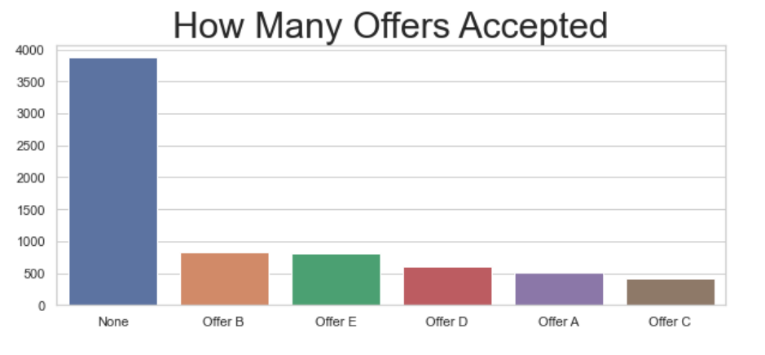

Slide 12

Customer Classification

Slide 13
Unsupervised learning used to categorize the customers.
Performed 4 different explorations on the clusters:
Using both PCA and t-SNE in K-means
Using t-SNE only in K-means
Using PCA only in K-means
Using hierarchical clustering by use of a dendogram

Slide 14
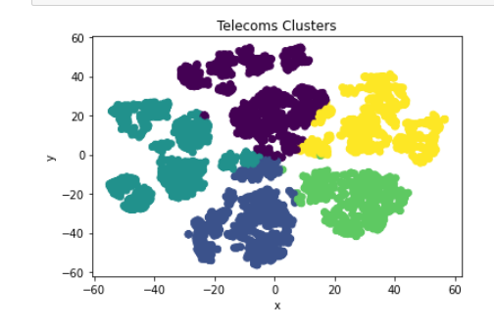
Customer Segmentation 1. Using PCA & t-SNE in K-Means
We used PCA for dimensionality reduction before we segmented the data. Combining PCA with K-means clustering is a great technique as it allows the algorithm to perform better when there are less features. We chose to retain 90% of the explained variance.

Slide 15
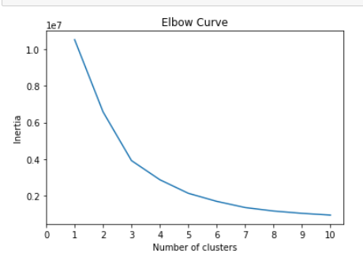
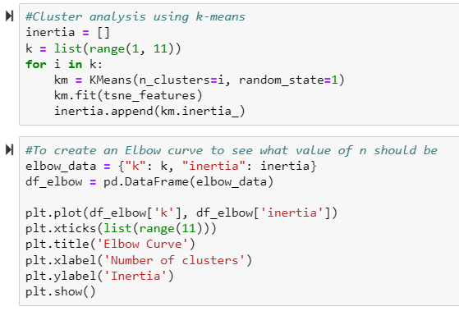
Elbow Curve
Used to determine the appropriate number of clusters in the data.
We selected 5 clusters from the shape of the curve.

Slide 16
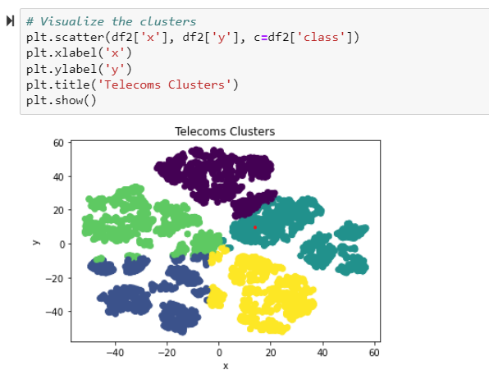
2. Using t-SNE in K-Means
t-SNE reduces the dimensions to 2 dimensions.
Clusters formed with some overlaps

Slide 17
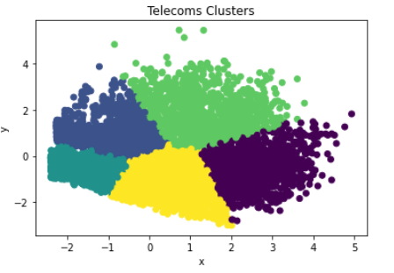
3. Using PCA in K-Means
Found most appropriate
Had clearer separation of the 3

Slide 18
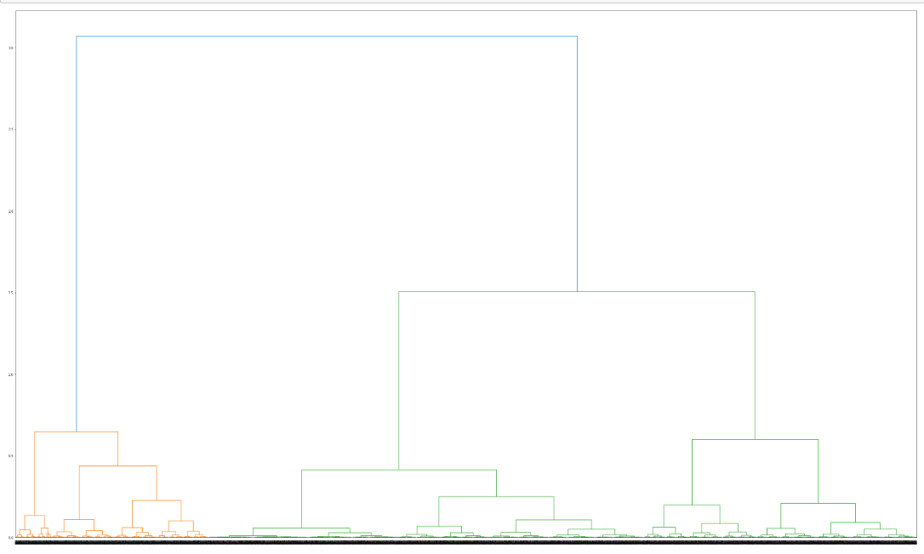
Hierarchical Classification
Tested to see the effectiveness
Clusters towards the bottom not clearly visible or identifiable
Not suitable because of the size of the data.

Slide 19
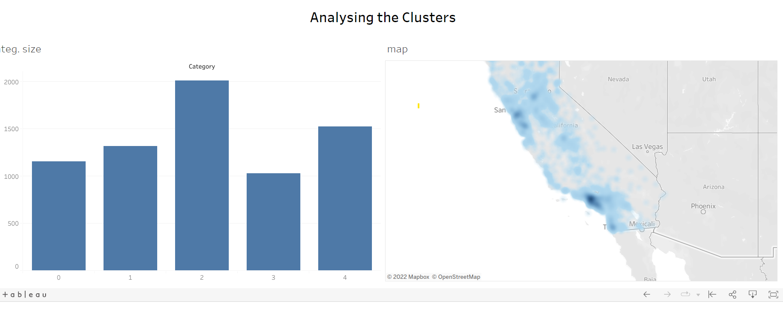
Tableau

Slide 20

Demo

Slide 21
Customer Profiles
Cluster 0
Cluster 1
Cluster 2
Cluster 3
Cluster 4
Almost all married (highest % of married people),
Mostly on a two-year contract,
but also incurring extra data charges and long-distance charges
> 70 months
Second lowest churn rate.
Mostly non-married,
Lowest revenue
Mostly month-month contracts
Incurring the least extra data and long-distance charges
Most have not been with the company long.
Almost all non married
Bringing in 2nd lowest revenue
Mostly month-month contracts
Incurring lots of extra data charges but not much long distance charges
Mostly new to the company
Highest churn rate.
Almost all married
3rd lowest revenue
Mostly on 2-year contracts, incurring hardly any extra data charges
Sizeable amounts have been with the company for more than 70 months.
Lowest churn
Majority are non-married,
month-month & 1-year contracts
Mostly not incurring extra data or long-distance charges
Been with the company for at least 3 years (hardly any new customers)
Low churn

Slide 22

Conclusion
PCA and K-means were found to be better at forming clusters for classification
Some clusters contained almost similar information.
The customer segments produced with the algorithms can prove very useful for the Telecom company to look at reasons for high customer churn, create better offers for customers, and know exactly which customers to target with these offers and thereby increase their revenue.

Slide 23


